Slide 1

Exception Handling
Christian Romero

Slide 2
What are Exceptions?
Dealing with Exceptions
Best Practices

Slide 3
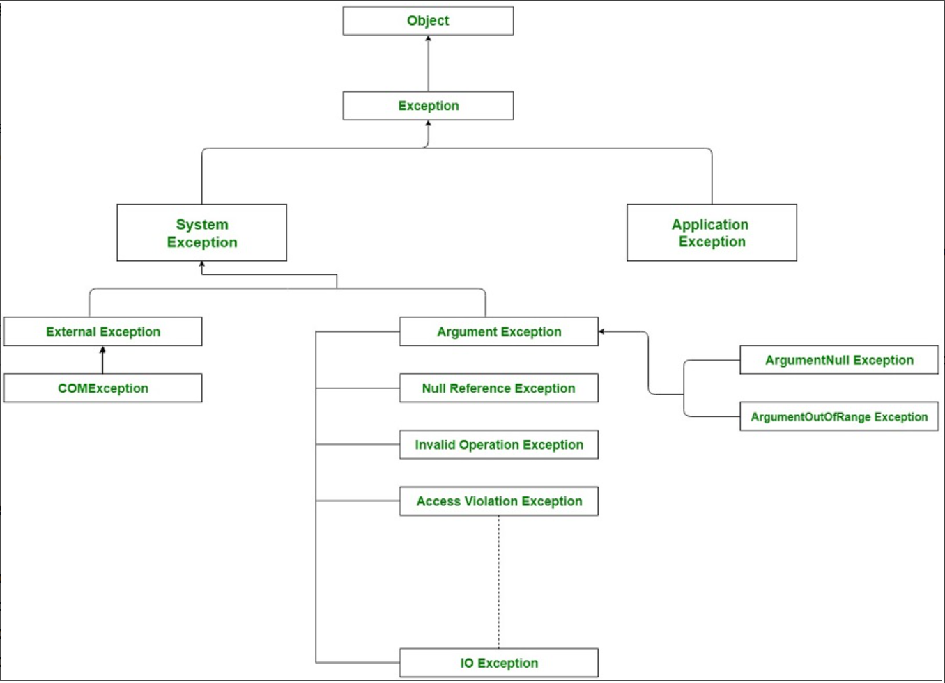
What are Exceptions?
“Any error condition or unexpected behavior that is encountered by an executing program”
Exception Class Hierarchy
Common Exceptions
Errors and Exceptions
Exceptions properties
  Data
  InnerException
  StackTrace
  Etc.
Notes:
System.Exception
External Exception
COMException
ArgumentException
Null Reference Exception – when method invoked onto null object ref
Invalid Operation Exception – common generic exception
Access Violation Exception -
IO Exception
Application Exception
Errors and Exceptions:
Usage errors = error caused by flawed, fixable program logic
Program errors = Depends. Sometimes it’s expect /routine error condition (Docs used basically usage error ) – sometimes it’s an unexpected error condition & requires EH
System failures = error cannot be handled programmatically (for example, any method can throw an OutOfMemoryException exception if the common language runtime is unable to allocate additional memory.)
Exception properties: StackTrace, InnerException, Message, HelpLink, HResult, Source, TargetSite, and Data.

Slide 4
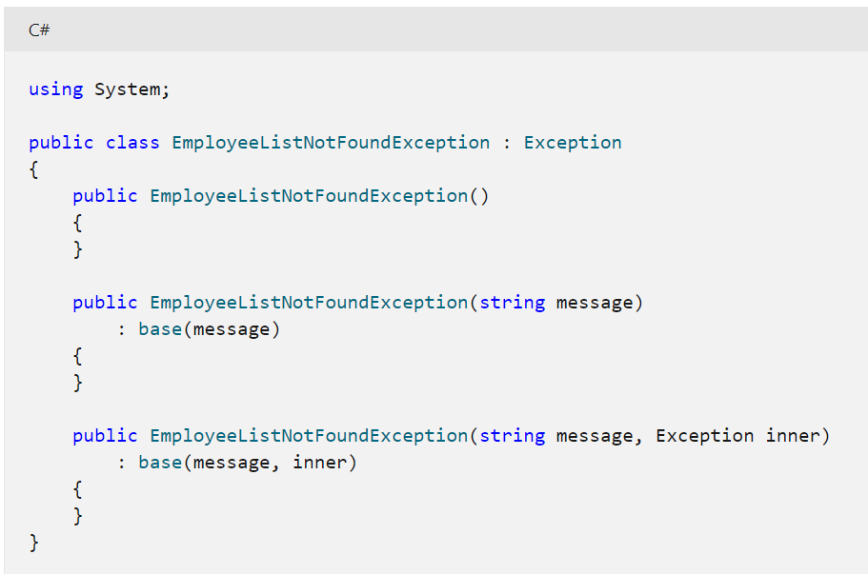
What are Exceptions?
User-defined Exceptions
Contain data about the error
Created with throw
Managed Exceptions vs Internal Exceptions
Notes:
User-defined: Classes that inherit from Exception class & ends w/ “Exception” & implements 3 common constructors. Used when .NET framework lacks proper exception type
Throw: Signals occurrence of exception & creates exception w/ original stack trace
Managed Exceptions vs Internal Exceptions:

Slide 5
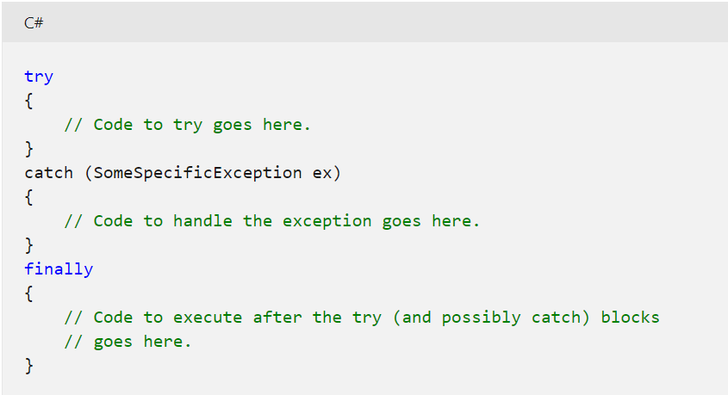
Dealing with Exceptions
Exception Handling is a technique for dealing with Exceptions
Try-catch-finally
Call stack unwinds for a catch block
Notes:
TCF:Try requires a catch and/or finally to compile
The try / finally allows you to write code that is guaranteed to execute even if a runtime exception is thrown by the code inside the try block.
This is good in situations where you are using code that might throw runtime exceptions but does not throw checked exceptions. An example of this is Spring DAO support; which wraps IOExceptions in runtime exceptions.
Stack unwinding: goes up the list of names of methods called at run time from the beginning of a program until the execution of the current statement.

Slide 6

Best Practices
Never catch base class System.Exception without rethrowing it at the end of the catch block.
Properly rethrowing exceptions
Use exception filters when appropriate
Throw exceptions only to handle extraordinary conditions, not predictable events/flow control.
Log Exceptions
Much More
Notes:
1: ?
2: Simply put a throw statement into the catch block to preserve all call stack info, because if you do throw (ex) you are ‘replacing’ the call stack info because making a new object/exception that has same stack trace property. Compiler sees instantiating new exception as same as passing in existing object(exception), and auto-populates stack trace property of throw commands w/ most recent throw
3: Exception filters are
4: Exceptions can be logged to a logging file using NLog, Serilog, or log4net & send these logs to Db, email, monitoring service, etc.
5: Exception handling uses a lot of system resources and should execution time. Don’t want to tax your performance, especially if can be handled through alternative route (if solvable programmatically)

